Slide 1
BSI Survey

Slide 2
BSI Survey
01
What is the survey?
02
Who was involved?
03
Results of the survey
04
Conclusion

Slide 3
What is the BSI-Survey?
01

Slide 4
What is the BSI survey
IT-Sicherheitsgesetzes 2.0
Survey about the new ”IT-Sicherheitsgesetz 2.0”
From the BSI (Bundesamt für Sicherheit in der IT)
Voluntary for critical infrastructure operators
Used to obtain information
on the current state of cybersecurity in these sectors
on plans to improve the cybersecurity
Improve the cybersecurity for the critical infrastructure
Increase safety awareness among the population

Slide 5
Who is it for?
02

Slide 6
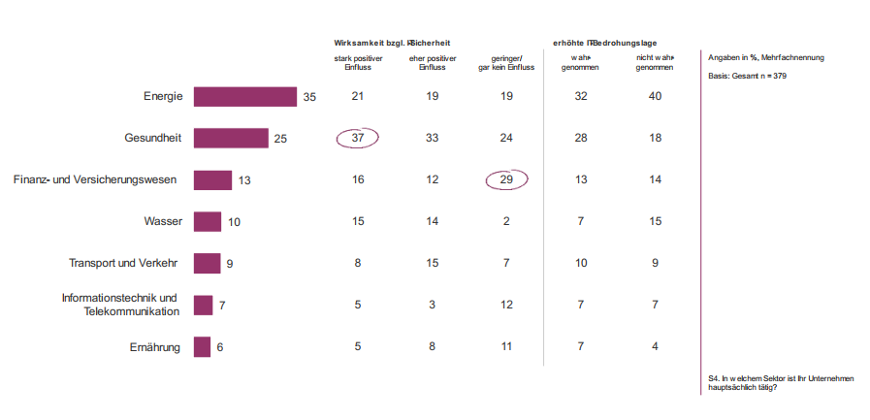
Who was involved?
More than 45% of the invited critical infrastructure operators participated
Notes:
Energy Health Finance

Slide 7
What are the results of that Survey
03
Notes:
PDF page 13/14
Page 17 (myb)
Page 24
Page 26(myb)
Page 31
Page 34

Slide 8
Conclusion
04

Slide 9
Sources
https://www.bsi.bund.de/DE/Themen/Unternehmen-und-Organisationen/Cyber-Sicherheitslage/Lageberichte/Cyber-Sicherheitsumfrage/cyber-sicherheitsumfrage_node.html
https://www.bsi.bund.de/SharedDocs/Downloads/DE/BSI/Digitalbarometer/Digitalbarometer-ProPK-BSI_2022.pdf?__blob=publicationFile&v=3
https://www.heise.de/news/BSI-Umfrage-Kritische-Infrastrukturen-haben-Nachholbedarf-bei-IT-Sicherheit-9323606.html

